Slide 1
Segmentation & paging

Slide 2
segmentation Basic method
Segmentation is a memory-management scheme that supports this programmer view of memory. A logical address space is a collection of segments.
Each segment has a name and a length. The addresses specify both the segment name and the offset within the segment. The programmer therefore specifies each address by two quantities: a segment name and an offset.
A logical address consists of a two tuple:
<segment-number, offset>
when a program is compiled, the compiler automatically constructs segments reflecting the input program.
A C compiler might create separate segments for the following:
1. The code
2. Global variables
3. The heap, from which memory is allocated
4. The stacks used by each thread
5. The standard C library

Slide 3
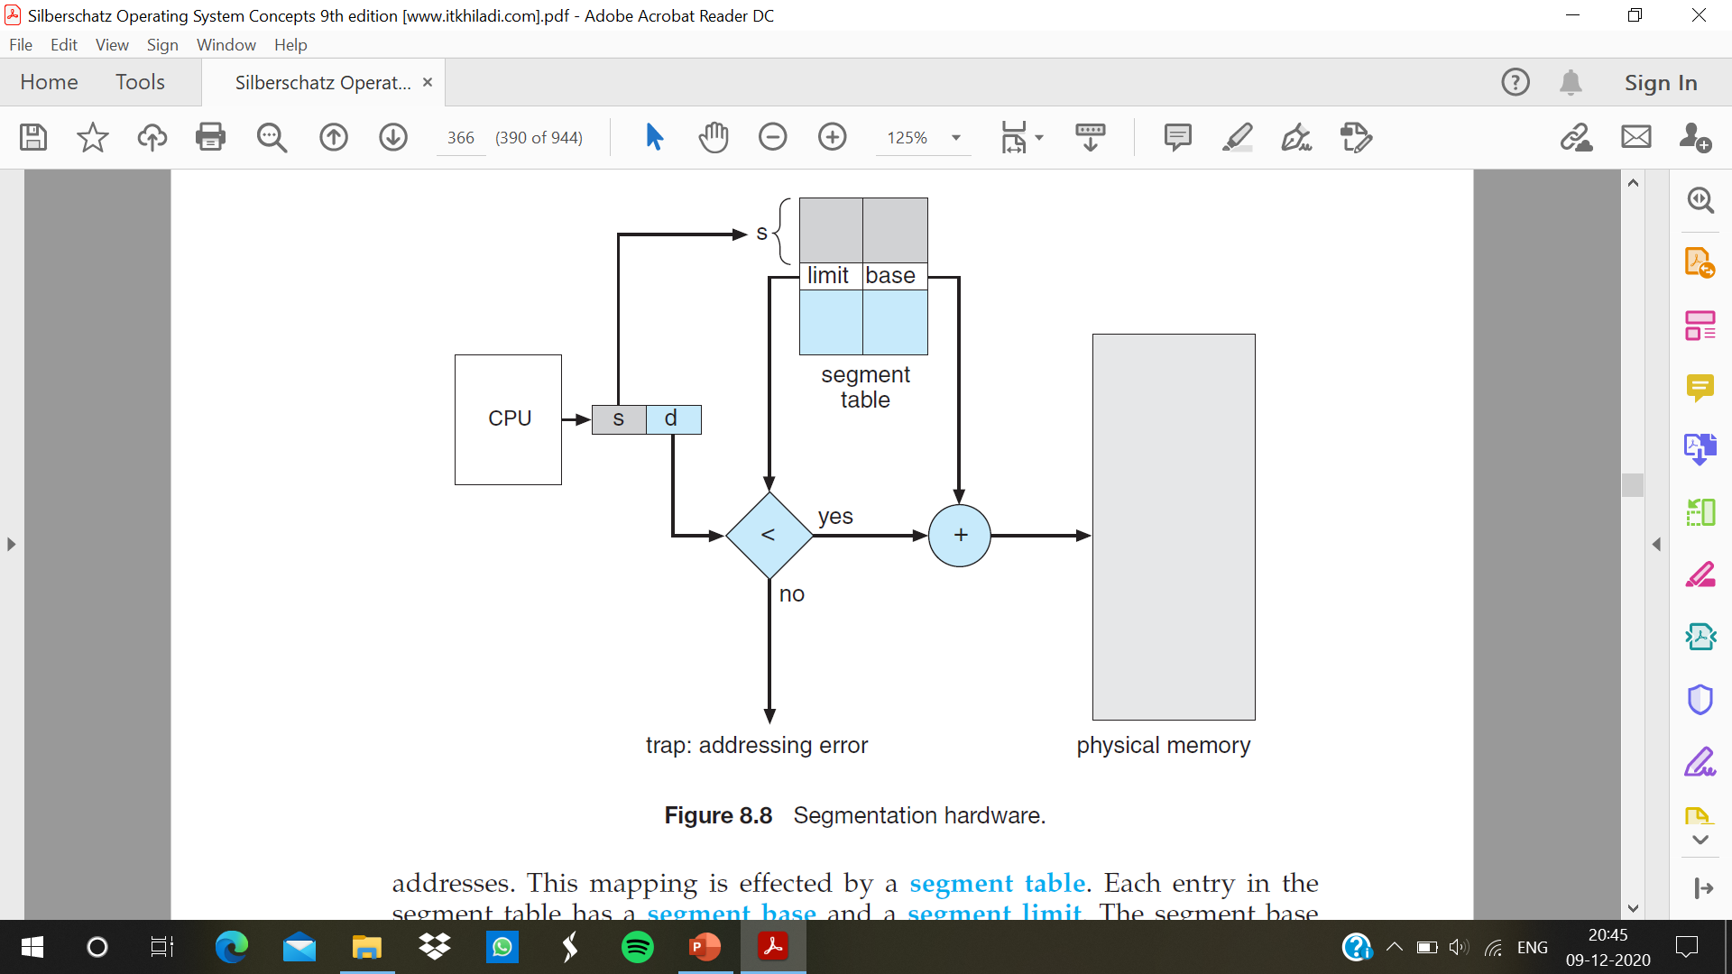
Segmentation Hardware

Slide 4
It is an implementation to map two-dimensional user-defined addresses into one-dimensional physical addresses. This mapping is effected by a segment table.
Each entry in the segment table has a segment base and a segment limit. The segment base contains the starting physical address where the segment resides in memory, and the segment limit specifies the length of the segment.
A logical address consists of two parts: a segment number, s, and an offset into that segment, d.
The segment number is used as an index to the segment table. The offset d of the logical address must be between 0 and the segment limit.
When an offset is legal, it is added to the segment base to produce the address in physical memory of the desired byte.
logical addressing attempt beyond end of segment then it is considered as illegal and trap to the operating system.
Segment table is kept in memory
Segment-table base register (STBR) points to the segment table’s location in memory
Segment-table length register (STLR) indicates number of segments used by a program

Slide 5
Paging basic method
Paging is a memory management scheme that eliminates the need for contiguous allocation of physical memory. This scheme permits the physical address space of a process to be non – contiguous. However, paging avoids external fragmentation and the need for compaction, whereas segmentation does not.
The basic method for implementing paging involves breaking physical memory into fixed-sized blocks called frames and breaking logical memory into blocks of the same size called pages.
When a process is to be executed, its pages are loaded into any available memory frames from their source (a file system or the backing store). The backing store is divided into fixed-sized blocks that are the same size as the memory frames or clusters of multiple frames.
Example: If Logical Address = 31 bit then Logical Address Space = 2³¹ words, If Physical Address = 22 bit then Physical Address Space = 2²² words
Page Size = Frame Size

Slide 6
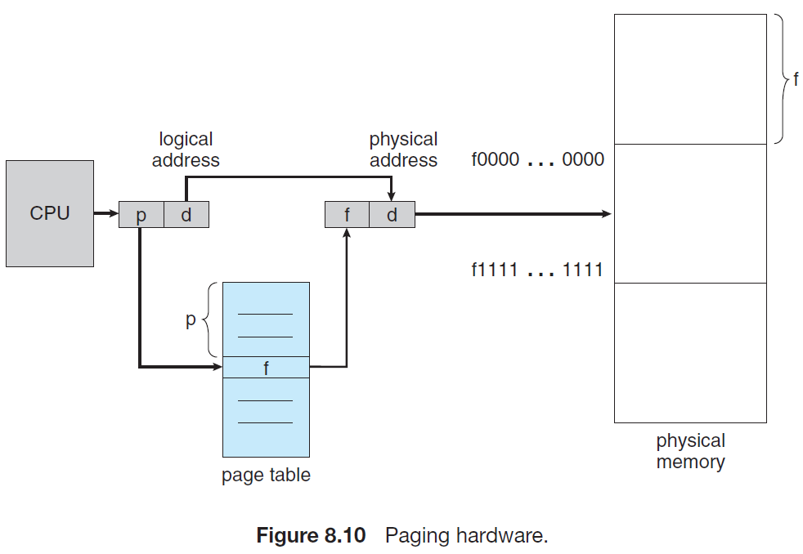

Slide 7
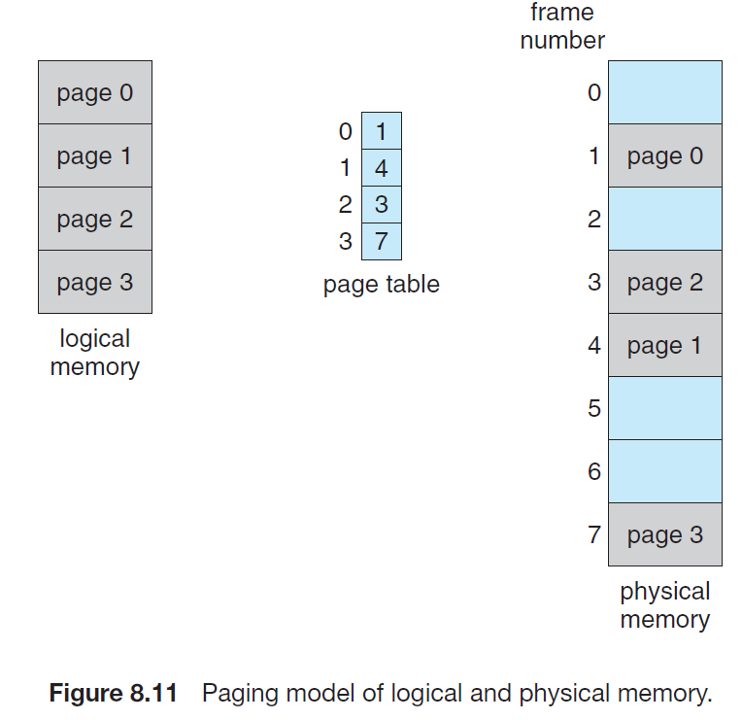
Every address generated by the CPU is divided into two parts: a page number (p) and a page offset (d). The page number is used as an index into a page table.
The page table contains the base address of each page in physical memory. This base address is combined with the page offset to define the physical memory address that is sent to the memory unit.

Slide 8
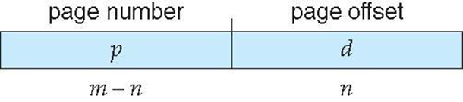
Page table is kept in memory.
Page-table base register (PTBR) points to the page table
Page-table length register (PTLR) indicates size of the page table
logical address space is 2^{m} and page size is 2^{n}
Address generated by CPU is divided into:
Page number (p) – used as an index into a page table which contains base address of each page in physical memory. Size of p is “m – n”
Page offset (d) – combined with base address to define the physical memory address that is sent to the memory unit. Size of d is “n”.

Slide 9
Hardware Support
The hardware implementation of the page table can be done in several ways. In the simplest case, the page table is implemented as a set of dedicated registers. These registers should be built with very high-speed logic to make the paging-address translation efficient.
Every access to memory must go through the paging map, so efficiency is a major consideration. The CPU dispatcher reloads these registers, just as it reloads the other registers. Instructions to load or modify the page-table registers are privileged, so that only the operating system can change the memory map.
The use of fast registers to implement the page table is not feasible. Rather, the page table is kept in main memory, and a page-table base register (PTBR) points to the page table. Changing page tables requires changing only this one register, substantially reducing context-switch time
The standard solution to this problem is to use a special, small, fast lookup hardware cache called a translation look-aside buffer (TLB).

Slide 10
Translation look-aside buffer (TLB)
The TLB is associative, high-speed memory. Each entry in the TLB consists of two parts: a key (or tag) and a value.
When the associative memory is presented with an item, the item is compared with all keys simultaneously. If the item is found, the corresponding value field is returned. The search is fast;
A TLB lookup in modern hardware is part of the instruction pipeline, essentially adding no performance penalty. To be able to execute the search within a pipeline step, however, the TLB must be kept small.
The TLB contains only a few of the page-table entries. When a logical address is generated by the CPU, its page number is presented to the TLB. If the page number is found, its frame number is immediately available and is used to access memory.
If the page number is not in the TLB (known as a TLB miss), a memory reference to the page table must be made. Depending on the CPU, this may be done automatically in hardware or via an interrupt to the operating system. When the frame number is obtained, we can use it to access memory

Slide 11
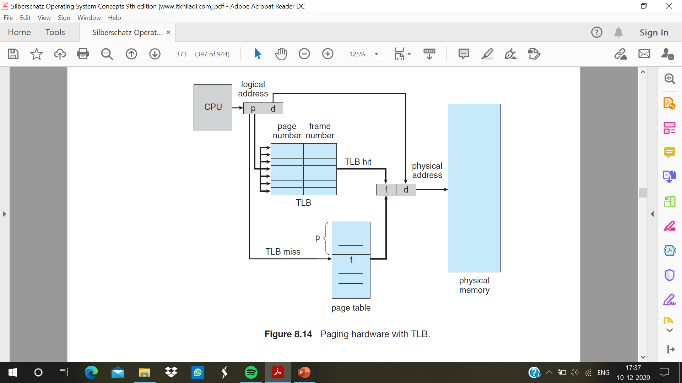

Slide 12
TLB issues
Some TLBs allow certain entries to be wired down, meaning that they cannot be removed from the TLB. Typically, TLB entries for key kernel code are wired down.
Some TLBs store address-space identifiers (ASIDs) in each TLB entry. An ASID uniquely identifies each process and is used to provide address-space protection for that process. When the TLB attempts to resolve virtual page numbers, it ensures that the ASID for the currently running process matches the ASID associated with the virtual page. If the ASIDs do not match, the attempt is treated as a TLB miss. Otherwise need to flush TLB at every context switch
The percentage of times that the page number of interest is found in the TLB is called the hit ratio. An 80-percent hit ratio, for example, means that we find the desired page number in the TLB 80 percent of the time.
Effective Access Time (EAT)
EAT = (1 + ε) α + (2 + ε)(1 – α)
= 2 + ε – α

Slide 13
Protection
Memory protection in a paged environment is accomplished by protection bits associated with each frame. Normally, these bits are kept in the page table. One bit can define a page to be read–write or read-only.
Every reference to memory goes through the page table to find the correct frame number. At the same time that the physical address is being computed, the protection bits can be checked to verify that no writes are being made to a read-only page.
An attempt to write to a read-only page causes a hardware trap to the operating system (or memory-protection violation).
Valid-invalid bit attached to each entry in the page table:
“valid” indicates that the associated page is in the process’ logical address space, and is thus is a legal page
“invalid” indicates that the page is not in the process’ logical address space
Some systems provide hardware, in the form of a page-table length register (PTLR), to indicate the size of the page table. This value is checked against every logical address to verify that the address is in the valid range for the process. Failure of this test causes an error trap to the operating system.

Slide 14
Shared Pages
An advantage of paging is the possibility of sharing common code. This consideration is particularly important in a time-sharing environment.
If the code is reentrant code (or pure code), however, it can be shared. Reentrant code is non-self-modifying code: it never changes during execution.
Thus, two or more processes can execute the same code at the same time. Each process has its own copy of registers and data storage to hold the data for the process’s execution.
Private code and data :
Each process keeps a separate copy of the code and data
The pages for the private code and data can appear anywhere in the logical address space

